Slide 1

Howard
Astronomical
League
12

Slide 2
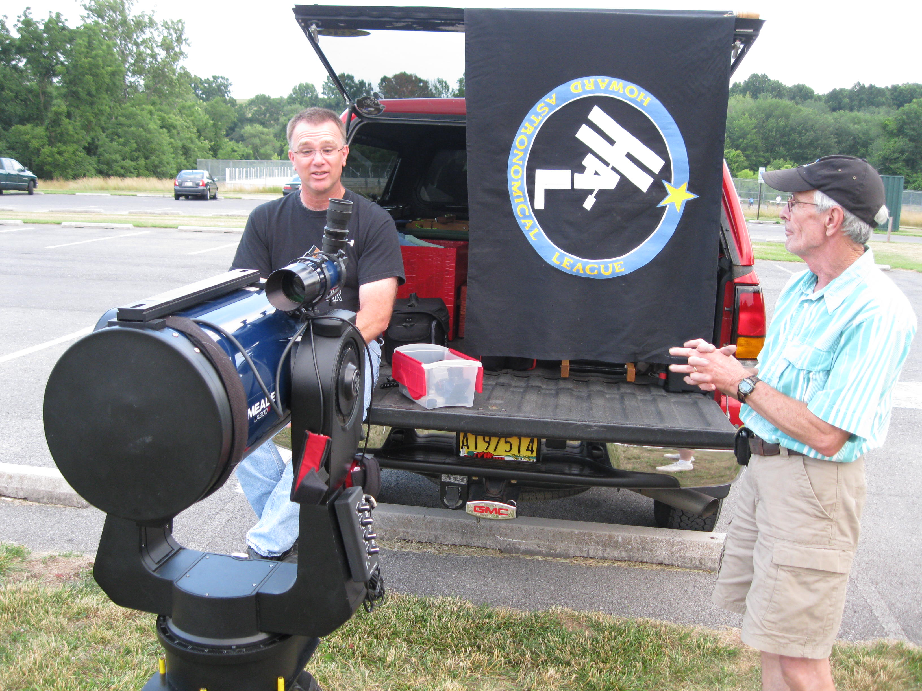
12
All Astro-images by HAL Members!

Slide 3
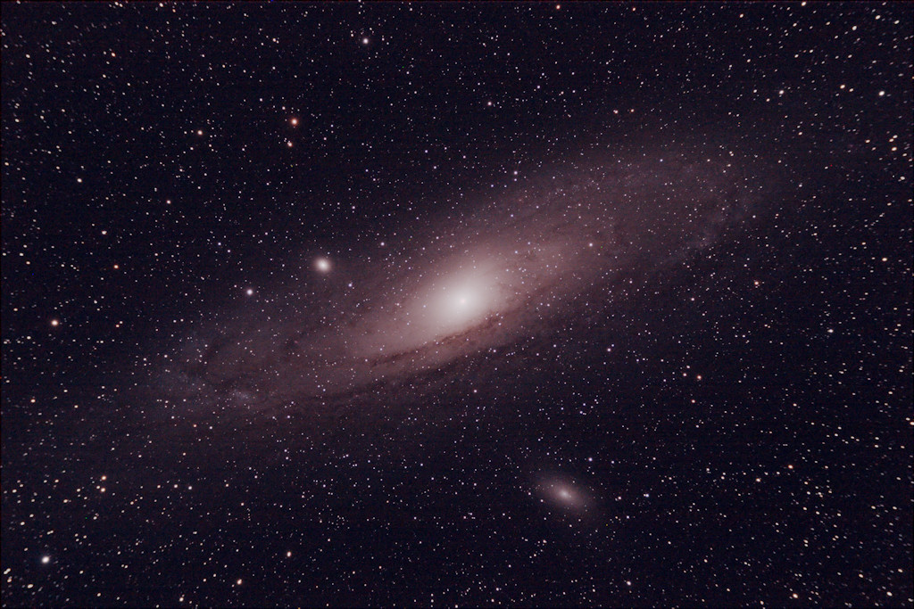
Andromeda Galaxy
Image by
Peter Friedman

Slide 4
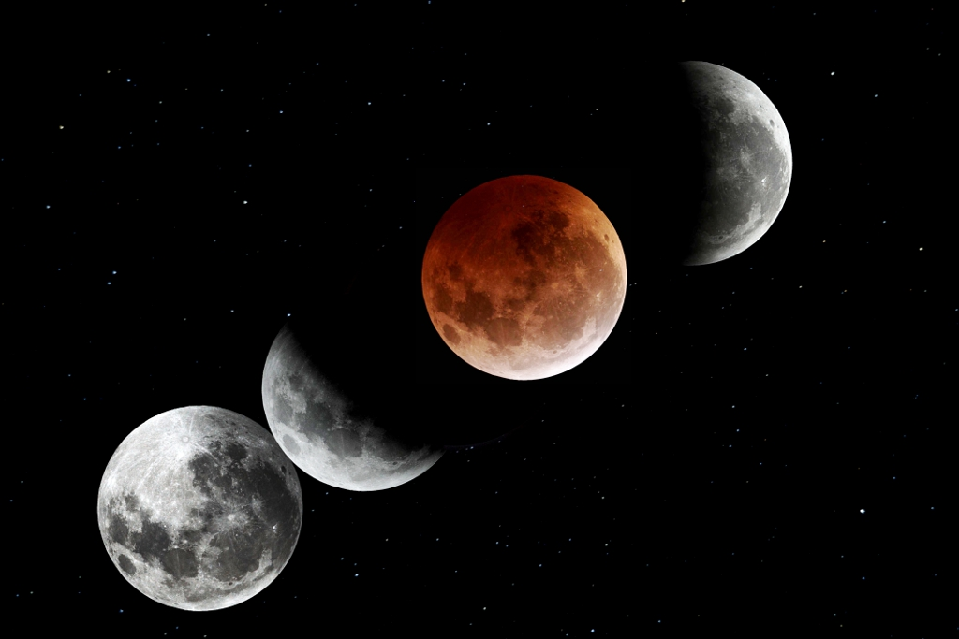
Lunar Eclipse
Image by
Gene Handler

Slide 5
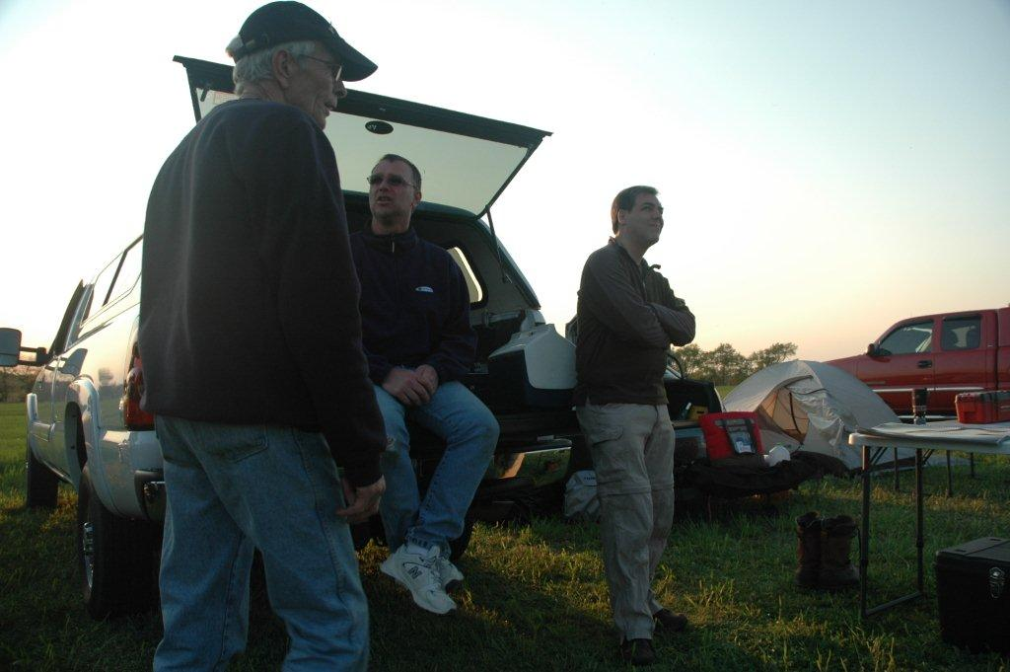
Light Pollution

Slide 6
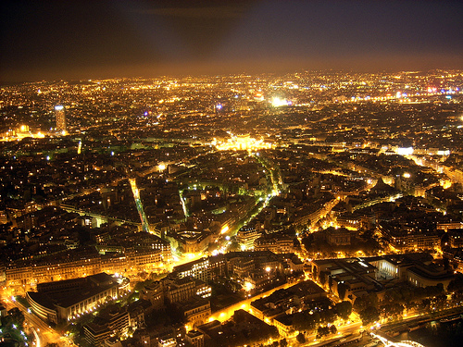
Wasteful

Slide 7
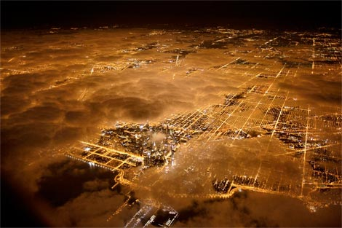
Harmful

Slide 8
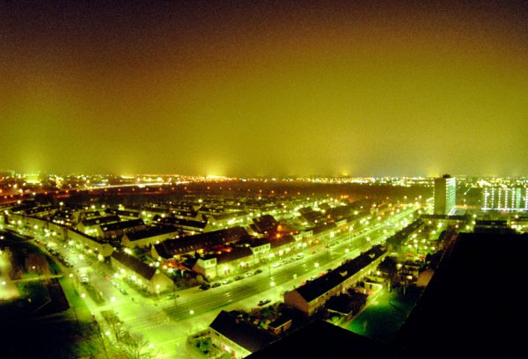
Ugly

Slide 9
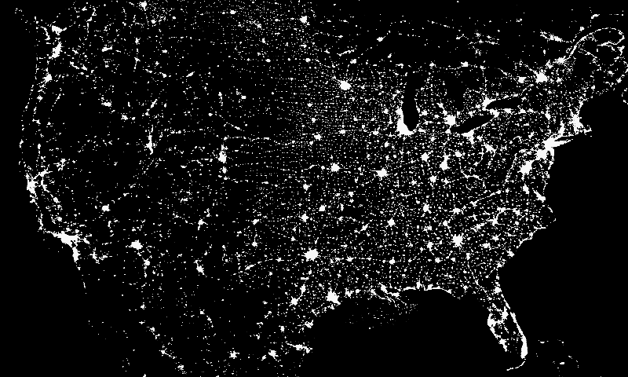
Billions in Wasted Energy

Slide 10
All the light you see here is waste… energy spent to light up space!

Slide 11
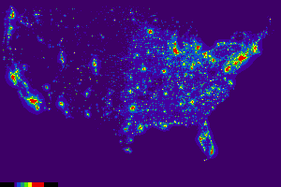
Can’t Escape It

Slide 12
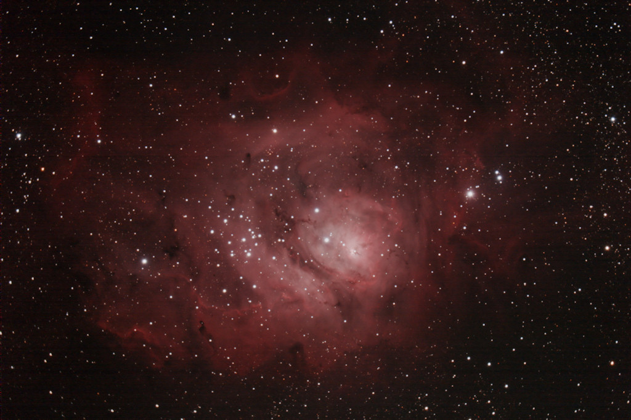
Lagoon Nebula
Image by
Peter Friedman

Slide 13
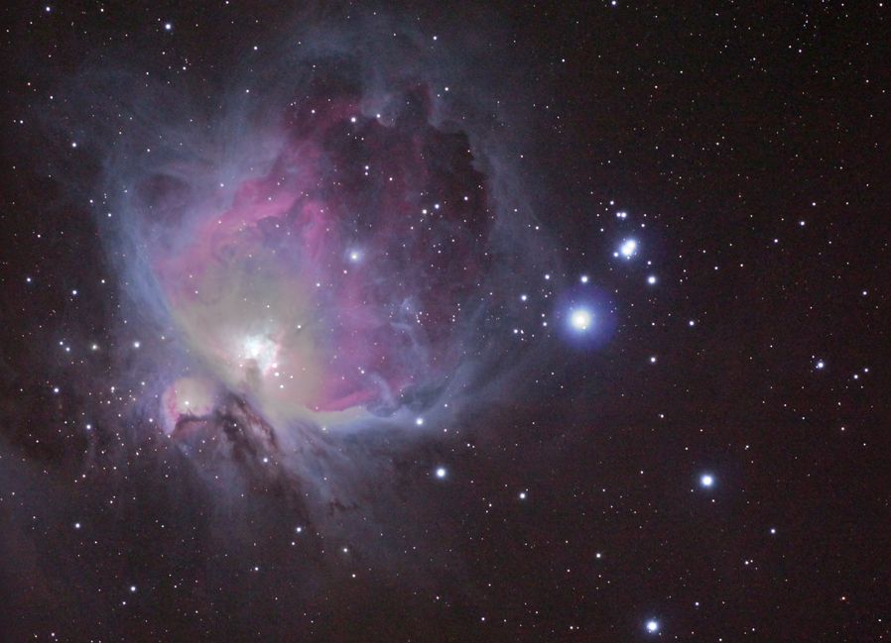
Great Nebula in Orion
Image by
Joe Bohanon

Slide 14
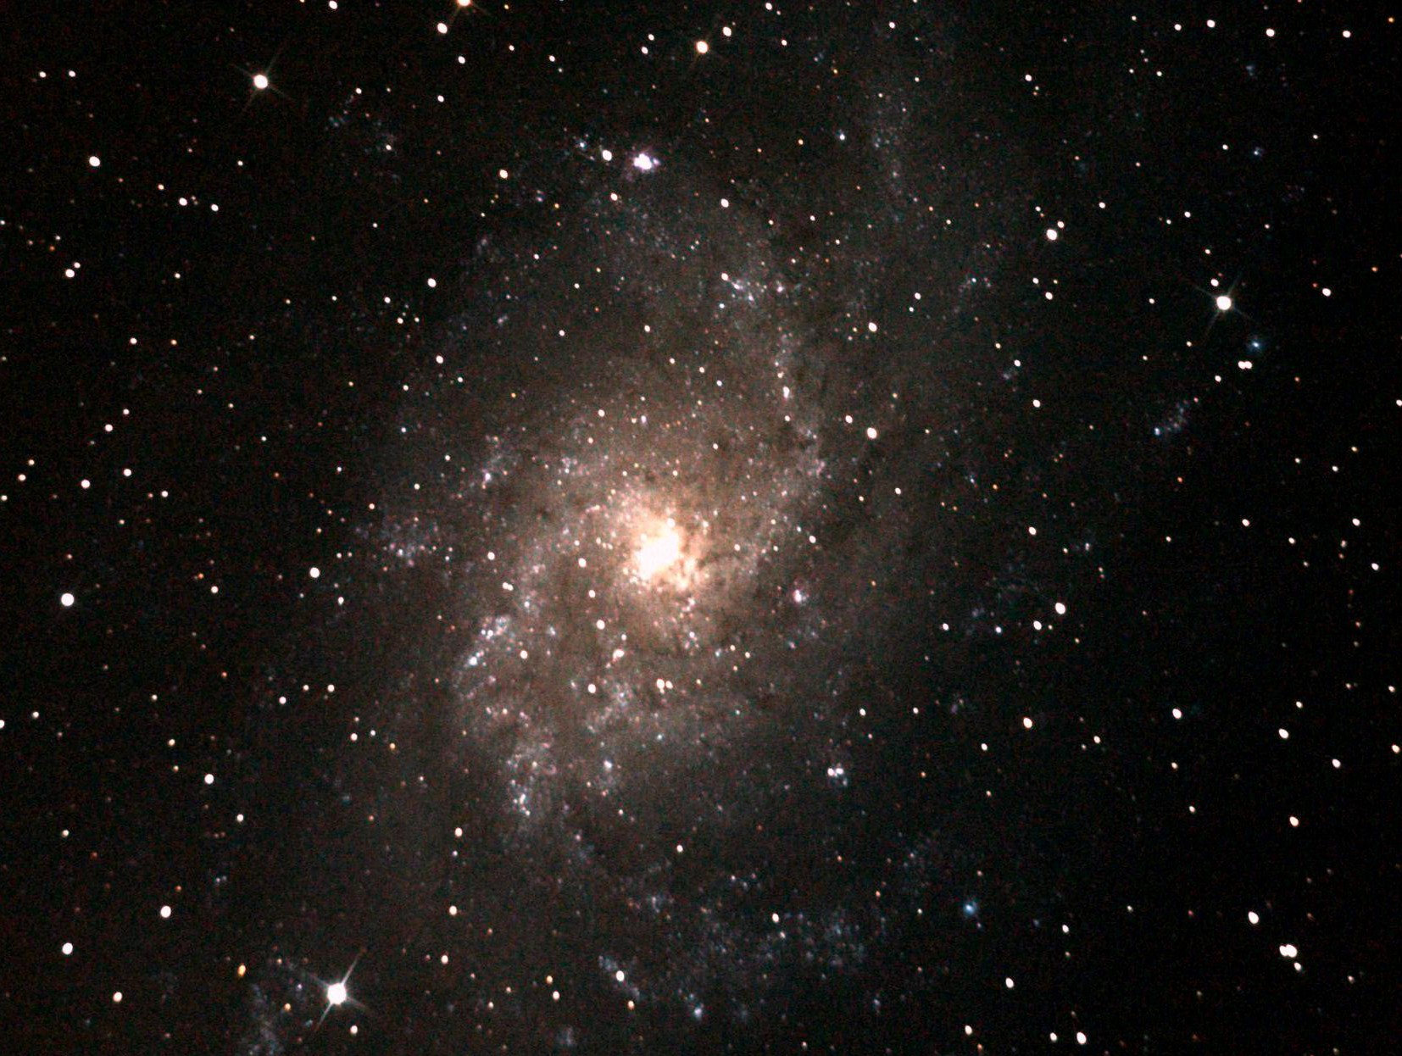
Triangulum Galaxy
Image by
Wayne Baggett

Slide 15
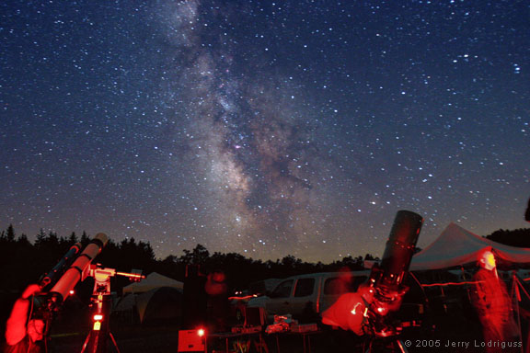
Dark Sky

Slide 16
Watch these
4 stars!
Dark Sky

Slide 17
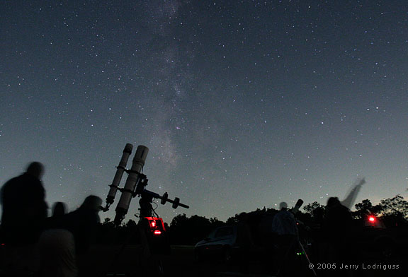
Not-So-Dark Sky

Slide 18
Not-So-Dark Sky

Slide 19
This is about as good as
it gets in Howard County

Slide 20
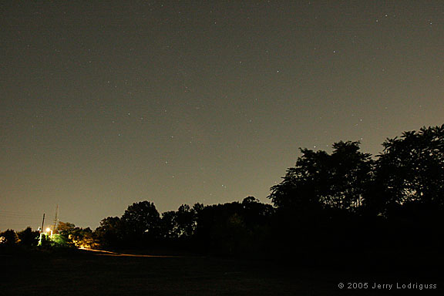
Light Polluted Sky

Slide 21
Light Polluted Sky

Slide 22
This is what the night sky looks like in most of Columbia

Slide 23
See what you’re missing?

Slide 24
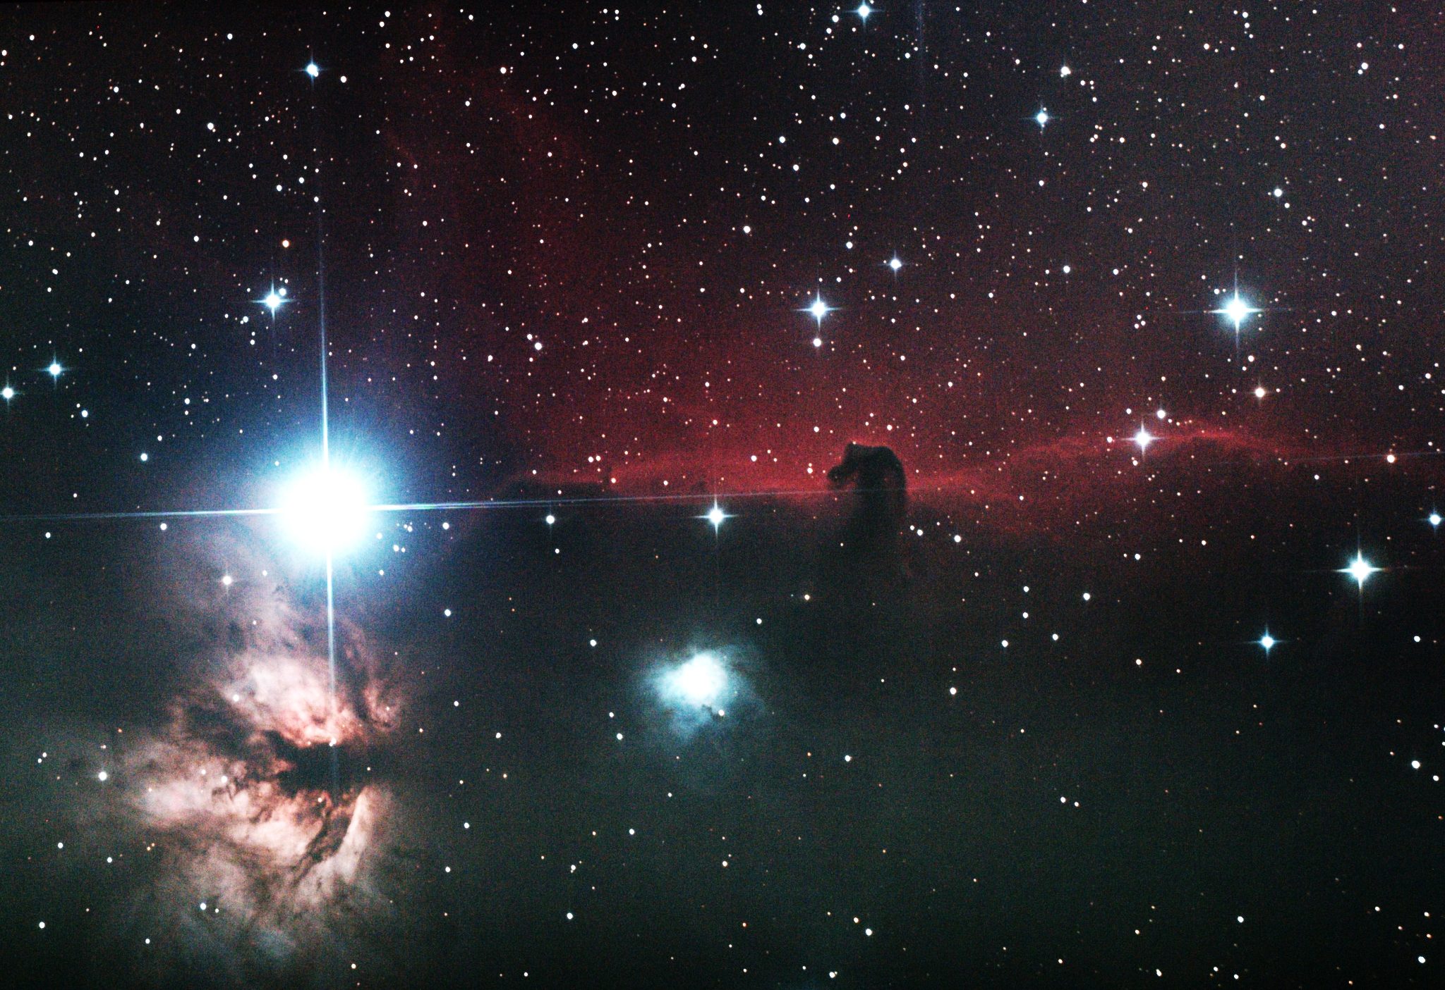
Horsehead Nebula
Image by
Gene Handler

Slide 25
12
www.howardastro.org

Slide 26
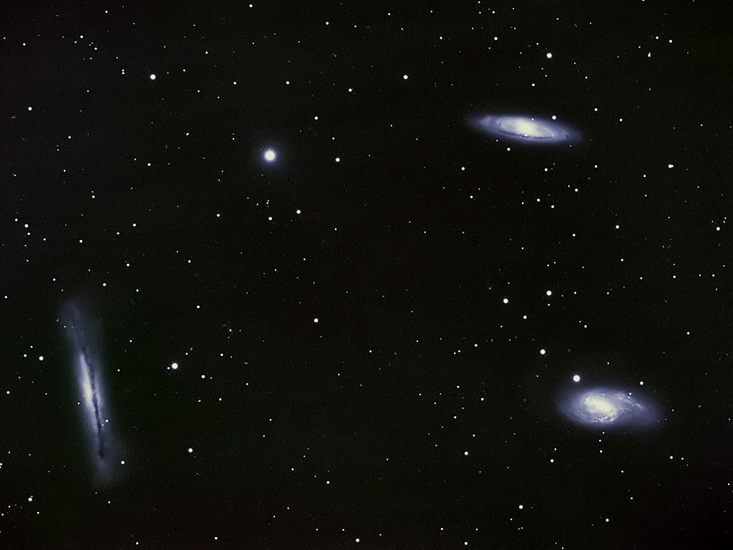
Galaxies in Leo
Image by
David Illig

Slide 27
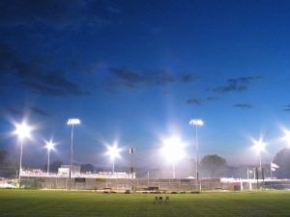
Light Pollution
hurts the environment!

Slide 28
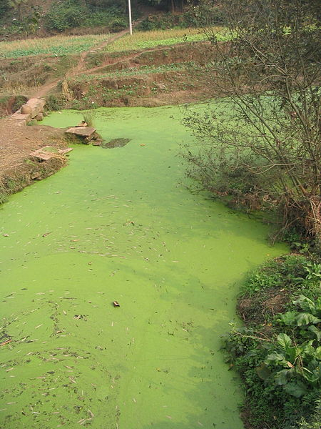
Algal Blooms

Slide 29
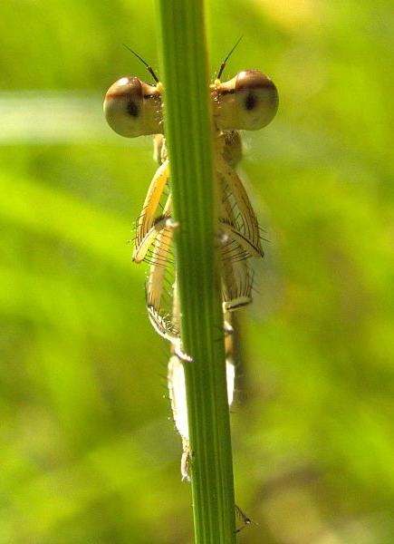
Insects Disoriented

Slide 30
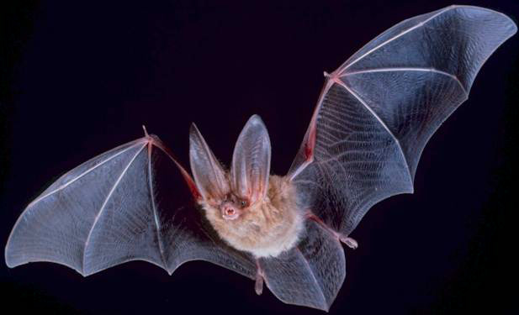
Food Chains Disrupted

Slide 31
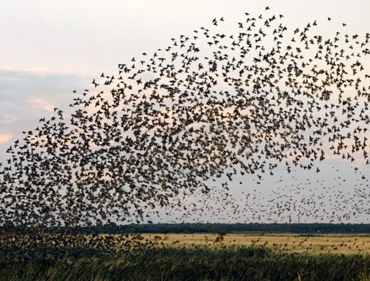
Animal Migrations Disturbed

Slide 32
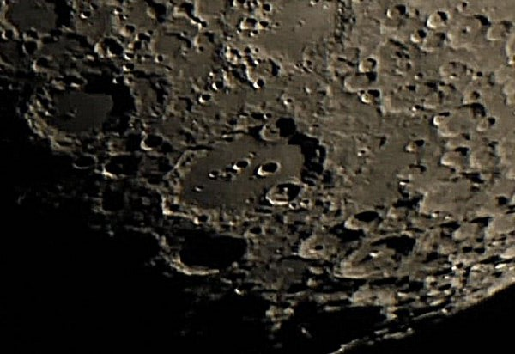
Clavius Crater
Image by
Peter Nerbun

Slide 33
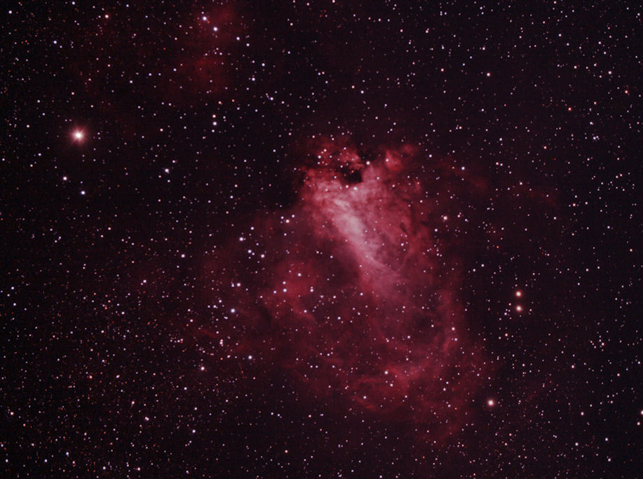
Omega Nebula
Image by
Peter Friedman

Slide 34
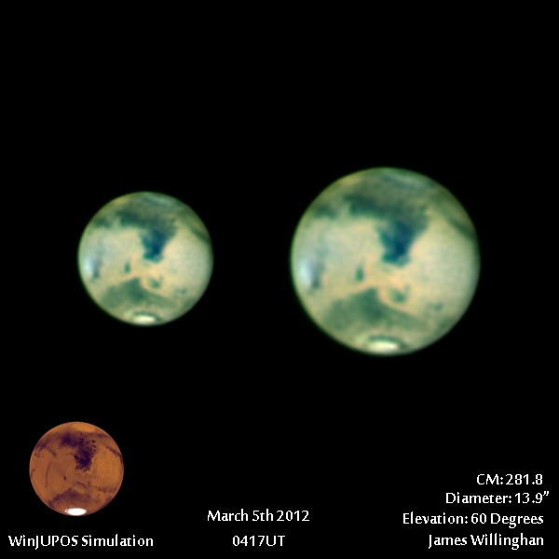
Mars
Image by
James Willinghan

Slide 35
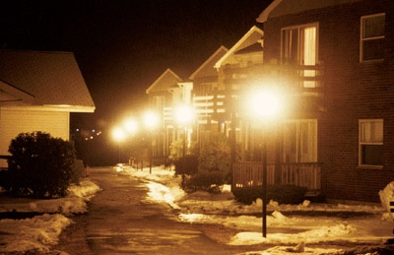
The Cause

Slide 36
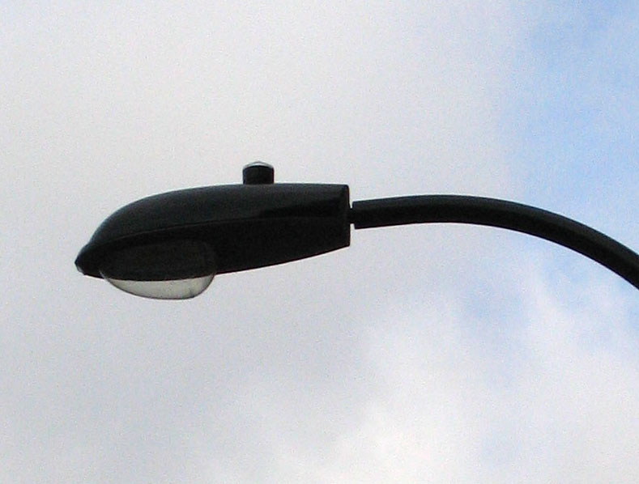
Insufficiently
Shielded Light

Slide 37
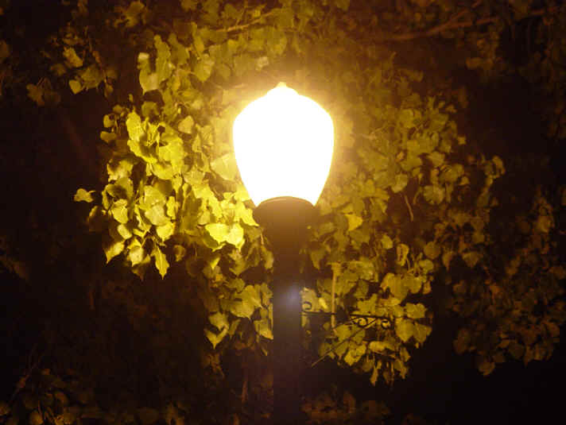
Totally
Unshielded Light

Slide 38
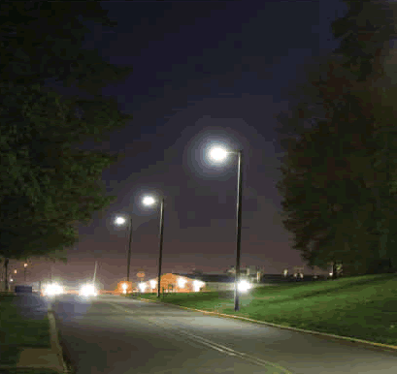
Light going where it’s not needed

Slide 39
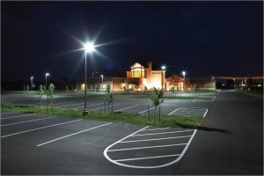
Light shining in your eyes

Slide 40
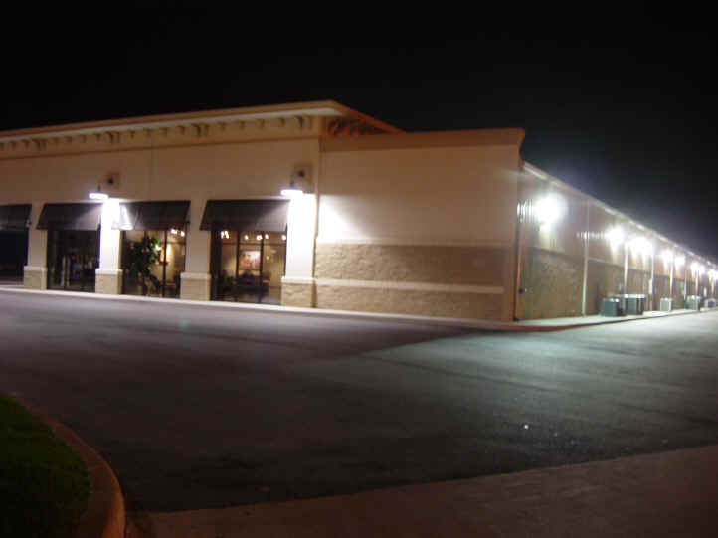
Light going in
Unintended Directions

Slide 41
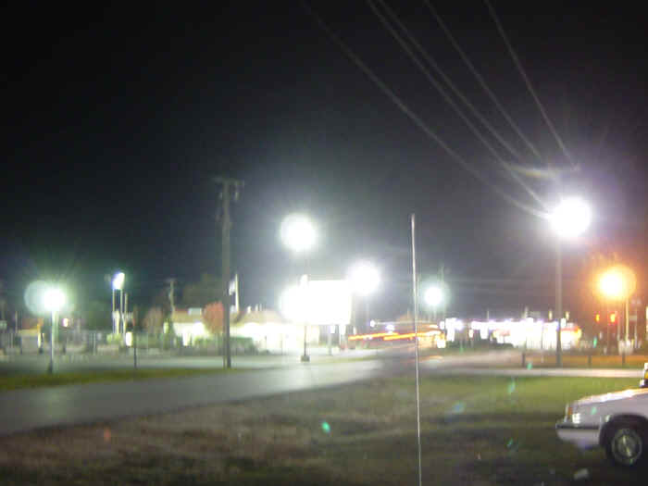
Over-illumination

Slide 42
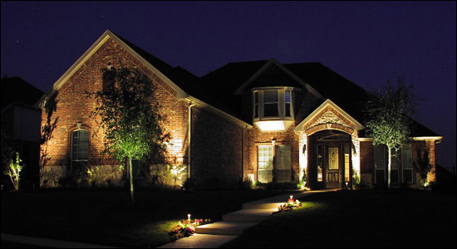
Light Shining Upward

Slide 43
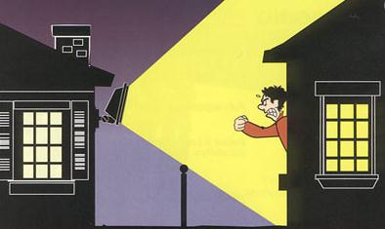
Light Trespass

Slide 44
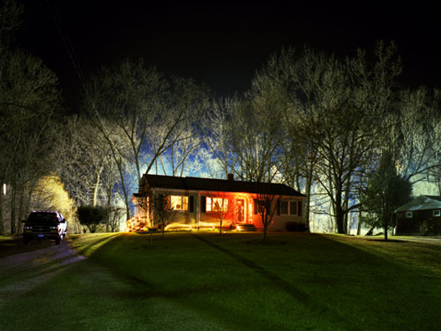
Do the neighbors ever sleep?

Slide 45
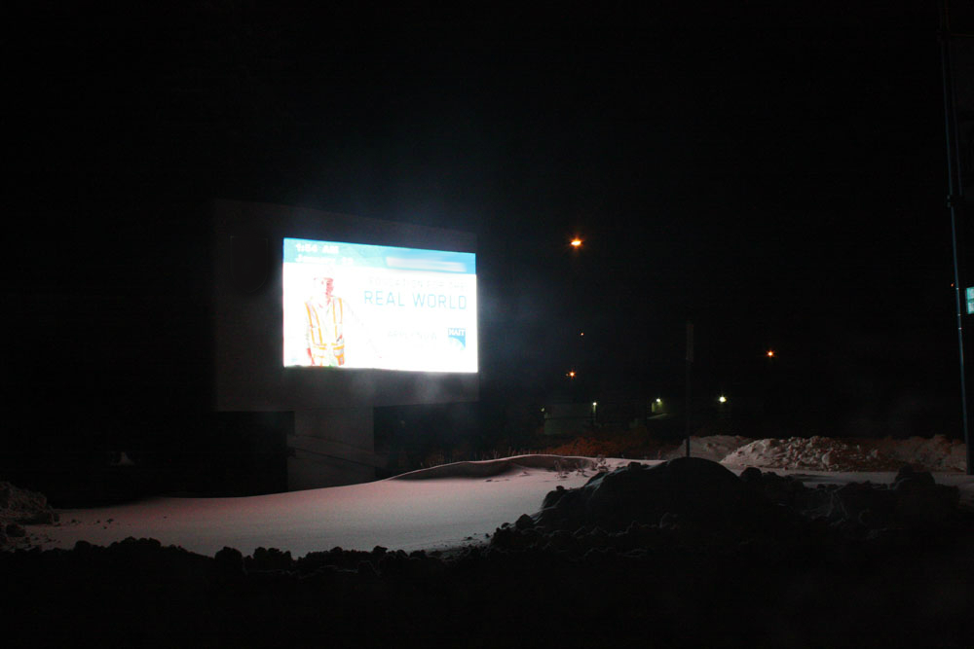
Dangerous and Distracting

Slide 46
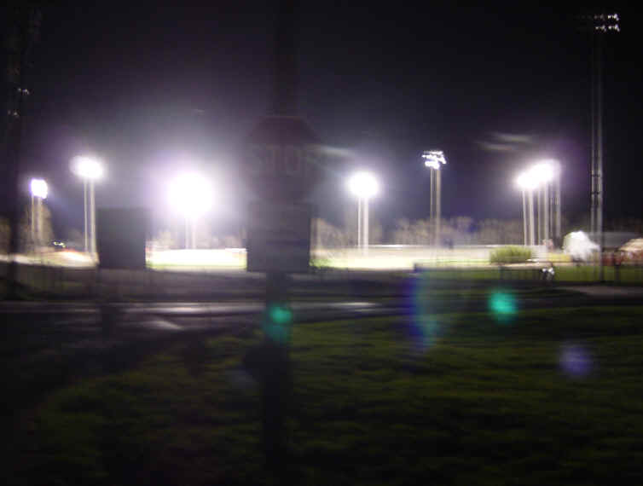
Where’s the Stop Sign?

Slide 47
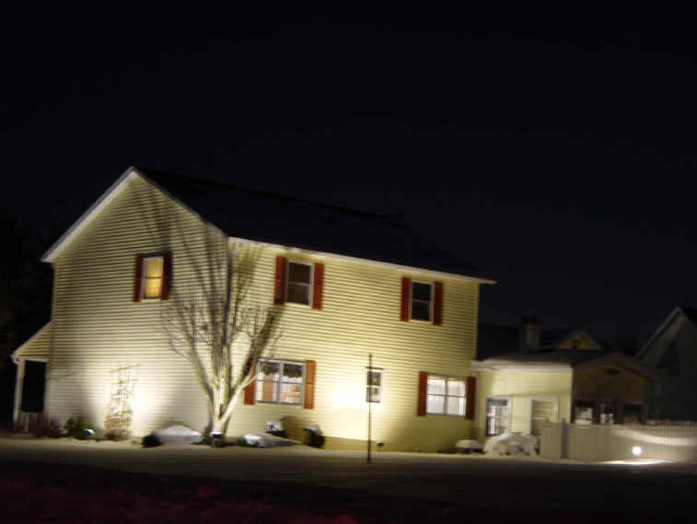
Why?

Slide 48
12
www.howardastro.org

Slide 49
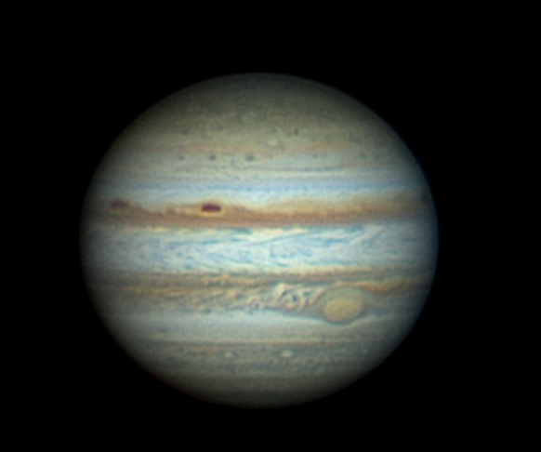
Jupiter
Image by
James Willinghan

Slide 50
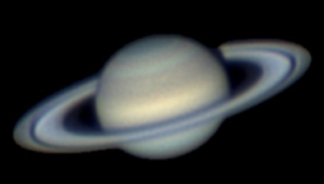
Saturn
Image by
James Willinghan

Slide 51
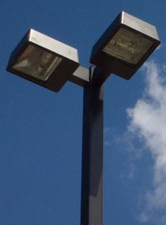
There Are Solutions!

Slide 52
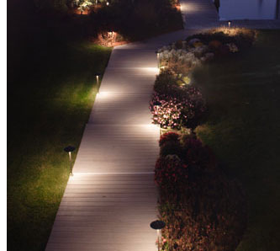
Light where you want it to go

Slide 53
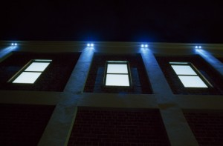
Light shining downward

Slide 54
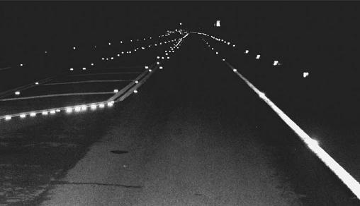
Replace streetlights
with Imbedded Lighting

Slide 55
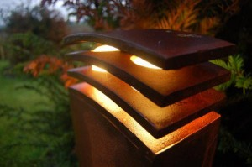
Light doing what you want it to do

Slide 56
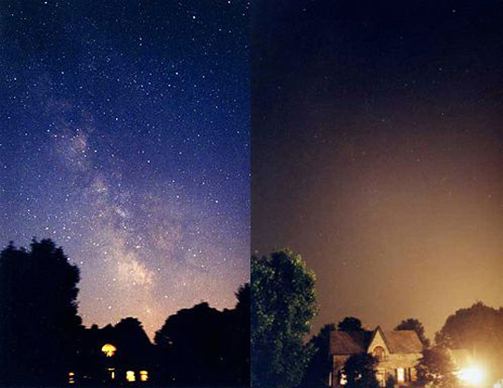
“Normal” Blackout

Slide 57
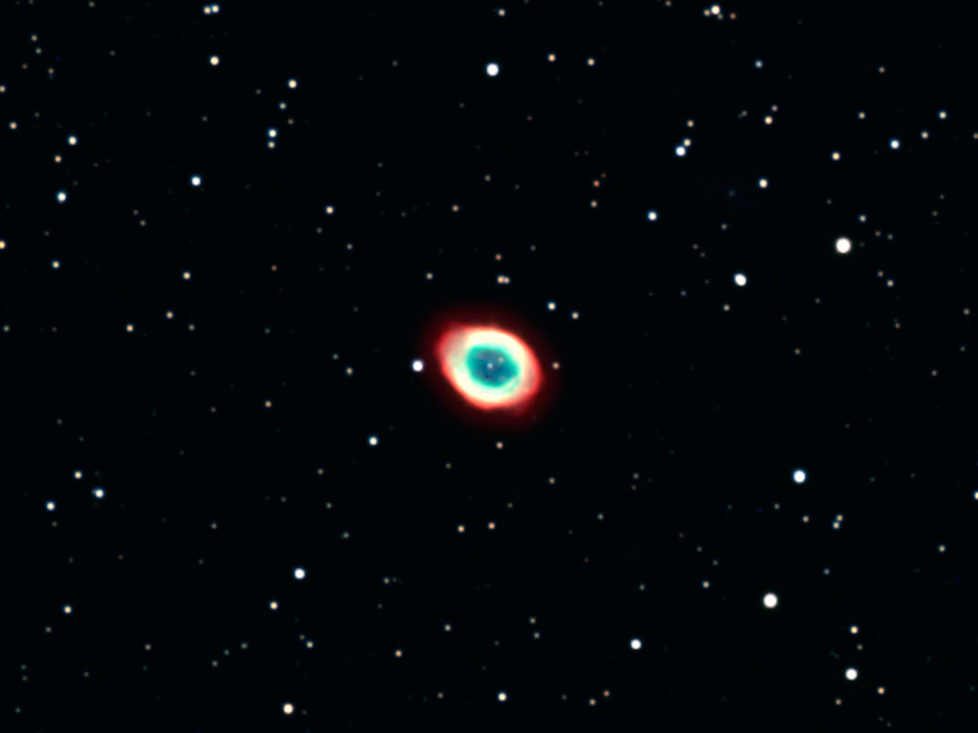
Ring Nebula
Image by
David Illig

Slide 58
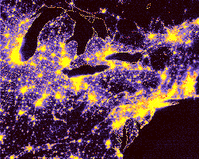
It doesn’t have to be this way!

Slide 59
Copernicus Crater
Image by
Eddie Crawford

Slide 60
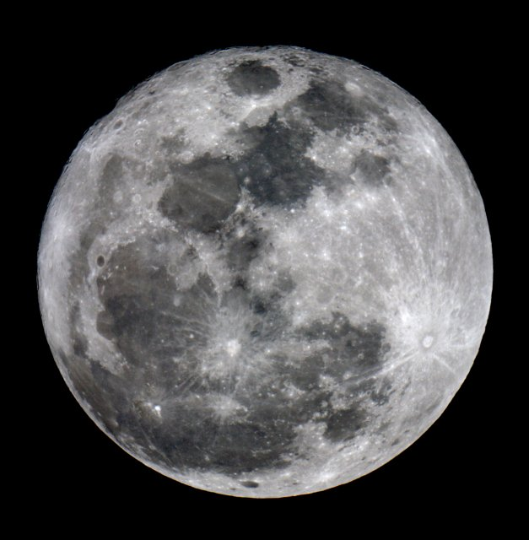
Full Moon
Image by
James Willinghan

